Slide 1
Respiratory Therapists: Breathing Life Into Healthcare
Notes:
This slide deck is distributed under the terms of the Creative Commons Attribution Non-Commercial License, which permits reuse, distribution and reproduction of the presentation without modifications, provided that the original work is properly cited and the reuse is restricted to noncommercial purposes.
There are notes and suggestions for the speaker accompanying these slides. They are not a script, however. There is a 45-second video on the second to last slide. If you hover over it while in Slide Show mode, you can play it. You will need an internet connection to do this.
This presentation is a short intro to RT. We have aimed to make this accessible for the middle/high school audience and public to provide them with introductory information on the profession.
We encourage you to also bring equipment or other visuals with you. This could be as simple as a stethoscope, oxygen masks and cannula, inhalers, and/or pulse ox, to more elaborate equipment like an intubation mannequin, spirometer and associated supplies. Of course, what you bring with you depends on what you have access to from your site.
If you use these slides, please let us know how it went! Send us an email and tell us about your event: csrt@csrt.com.

Slide 2
What is a Respiratory Therapist?
Respiratory therapists (RTs) are important and respected members of the healthcare team.
RTs are skilled professionals who help people of all ages manage problems with their lungs, heart and other organs (e.g., asthma, heart attack, respiratory failure).
RTs are unique in the healthcare system. They possess an expertise in cardiopulmonary care that other health professionals don’t possess.
Notes:
These are overview statements about RTs. Use your experience to expand on them if you wish. Things to consider mentioning:
Tell a story about a time you intervened in a way that other healthcare professionals couldn’t. For example:
Did you get a difficult airway?
Have you had a breakthrough moment with a patient where they told you that they finally understand when to use their medications?
Were you able to help mobilize a patient in ICU or manage the airway and ventilator circuit so that a parent could hold their newborn who required ventilation?
Did you help get a patient with complex respiratory needs back into their home?
Etc….
Talk about how RTs work within the larger healthcare team: RTs work alongside doctors, nurses, physiotherapists, pharmacists, etc., with each using their expertise to provide safe, effective care, although they aren’t normally all seeing the patient at the same time.
Talk about the level of independence or autonomy RTs have based on your experience.

Slide 3
Where do Respiratory Therapists Work?
Emergency rooms
Primary care clinics
Diagnostic labs
Operating rooms
Sleep labs
Non-urgent care hospital units
Community care settings
Intensive care units
Notes:
This slide does not encompass all of the areas where RTs work, but captures the most common settings where RTs work and those that we get asked most about from people wanting to learn more about the profession. You can also mention other areas too: equipment and pharmaceutical manufacturers, associations and regulatory colleges, management roles, research, entry to practice education….
Things to consider mentioning:
Share your RT story with the audience – where do you work or where have you worked?
How essential RTs were throughout the pandemic (life-saving treatments such as oxygen therapy or the insertion of airways and mechanical ventilation for patients no longer able to breathe for themselves). Respiratory therapists were on the frontlines in all communities, providing care to Canadians in hospitals, in their homes, and virtually. They also worked in vaccination clinics.

Slide 4
What do Respiratory Therapists do?
Assess patients, perform medical tests and provide a variety of treatments for cardiopulmonary disease
Educate patients about lung health and the use of their breathing medications and devices to manage their own care
Provide airway and breathing support to patients in hospitals, clinics, the community and patients’ homes
Participate in research that helps improve healthcare and quality of life
Advise government and decision makers on aspects of respiratory care
Notes:
These are broad statements about what RTs do. Consider expanding on each or describing your typical shift.

Slide 5
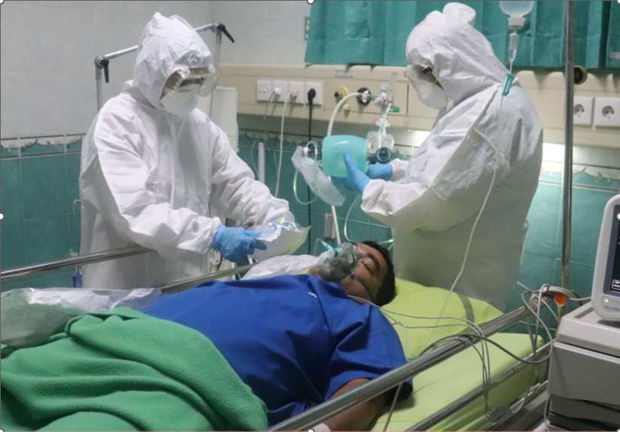
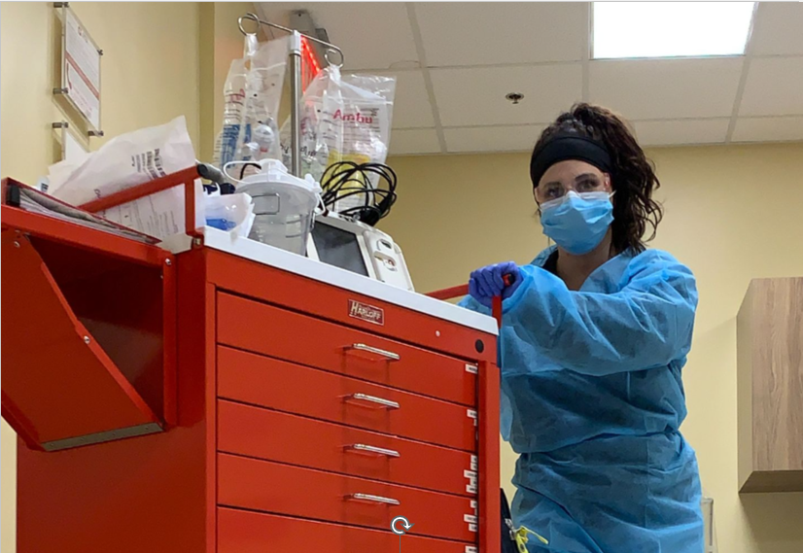
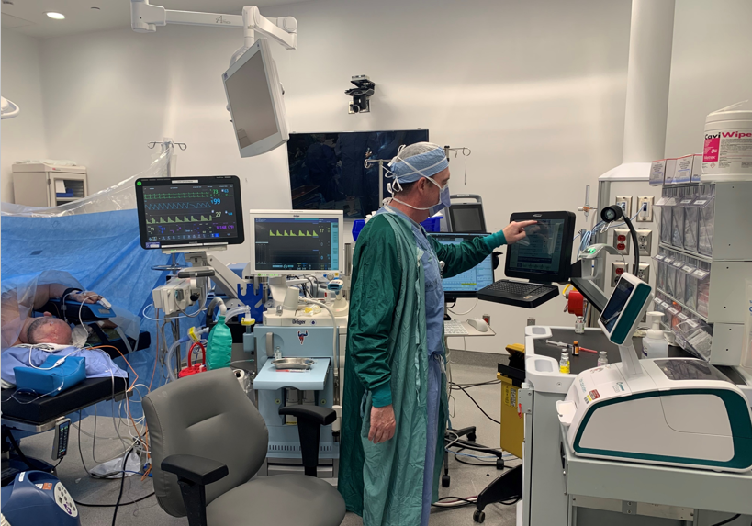
Notes:
These are some generic photos of what RTs do:
Overflow ICU care during COVID-19 pandemic
Patient education
Resuscitation Prep
Anesthesia assistance
Speak to your experience: Where specifically do you work? What else have you done as an RT?

Slide 6
How does someone become an RT?
Respiratory therapists graduate from three- or four-year programs (or equivalent) that include theory, lab and clinical components. In most jurisdictions, passing a credentialling exam and/or a license to practice is required following graduation.
Notes:
Consider finding out about your local program and letting the audience know about it. Or, tell them about your education to become an RT.
Different RT programs have different admissions requirements, so encourage the audience to check college/university websites to find out more.
Typically, students complete theory and labs before an extensive clinical education component. Each RT program is a bit different (some may have some clinical experiences in the first year, for example), but accredited programs meet educational standards for RT. A list of accredited programs is available online through Accreditation Canada, but most audiences will not ask about this specific a detail. And, there is more information about this on the CSRT website at the QR code at the end of this slide deck.
Colleges offer diplomas or advanced diplomas, and there are degree completion options for those who have graduated from a college-based program. There are also university programs offering a degree.
The requirement to pass the national RT exam (from Health Professionals Testing Canada, formerly the CBRC) varies across Canada. Quebec does not require this, for example.

Slide 7
What are the job prospects like?
Data from the federal government and the Canadian Society of Respiratory Therapists indicate a strong need for RTs in the next few years!
RTs can move from one province and work in another, but a provincial license to practice is required in most provinces.
The Canadian RRT credential is well-respected internationally.
Notes:
Why we need more: retiring RTs, RTs moving into new roles in higher numbers (e.g., management), aging population, increase prevalence of chronic and acute respiratory diseases, RTs’ expertise being used to fill gaps due to doctor and nursing shortage (examples: anesthesia assistants, RTs being used in emergency rooms), career changes out of healthcare
There is reciprocity for licenses between provinces. (An RRT still needs to contact the licensing body if moving to a regulated province. As of fall 2023, BC and the territories are unregulated.)

Slide 8
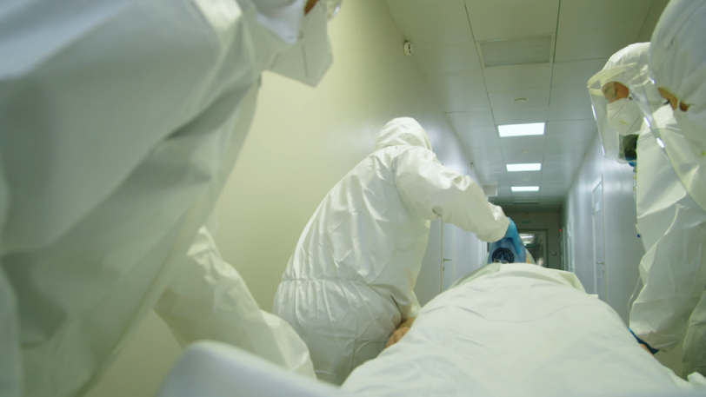
Notes:
This links to a 45-second video about RTs. You will require an internet connection to play this during your presentation. It is geared toward the average member of the public and uses re-enactments to demonstrate some of what RTs do. There is a longer (2 minute version) available as well. If you wish to use that version, contact the CSRT or download that version from the RT Week resources.

Slide 9
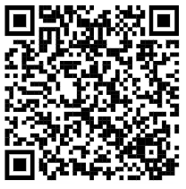
For more information, contact the Canadian Society of Respiratory Therapists: www.csrt.com 1-800-267-3422 csrt@csrt.com

